Slide 1
Intro to Applied Data Science
MMCi Weekend 1
Matthew Engelhard
Notes:
I’m MME and this is ADS.
What a year for DS!
LLMs
Bias and fairness
ABCDS

Slide 2
Course Objectives
You might not be building models, but you’ll use them. You should know:
What they can and can’t do (capabilities, limitations)
When and how much to trust their predictions (evaluation)
What’s inside the black box (interpretation, understanding)
Equip you to:
design and manage data science research and/or QA/QI projects
collaborate and communicate effectively with data scientists
add rigor to model development and validation
Notes:
Data science techniques are changing healthcare
You might not be building them, but you will be using them.
Understand what they can and can’t do (capabilities)
Know how to critically evaluate (trust)
Know how to interpret (understanding)
Intuitive, applications-oriented perspective

Slide 3
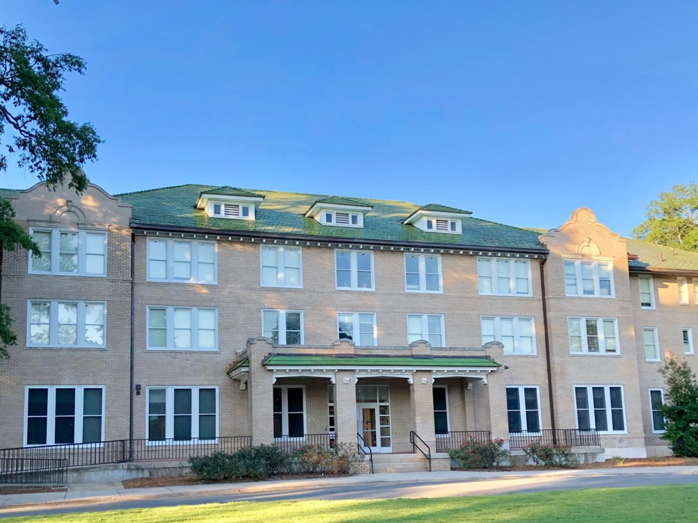

Notes:
My background
Duke undergrad
NSA
UVA
Back to Duke
Goal: get quants and providers to talk

Slide 4
Introductions!
your name
+ your role either just before MMCi or outside of MMCi
+ any other fact about yourself (e.g. a typical breakfast, last tv show you watched)
+ how you feel about the effects DS/ML/AI will have on health
(excited, worried, both, something else)

Slide 5
Course Overview
We will learn about state-of-the-art data science techniques that have changed or will change clinical practice.
How are these techniques different from what has come before?
How are they the same?
What do you need to know to use them effectively and responsibly?
I know that most of you are NOT going to be data scientists.
But you will work with data scientists, and you will have to make decisions about what models to use and how to use them. It is important to know enough to get in the weeds with the data scientists, because if applied/evaluated incorrectly, these models are certain to be unhelpful and likely to be harmful.
Notes:
Some of you will start building models
Some of you will start evaluating
All of you will learn how things can go wrong
And – I hope – how to engage in collaborative health DS

Slide 6
Course Logistics
Let’s take a look at the course site (in Canvas)
Questions & discussion about course requirements, materials, or activities
Contact me: m.engelhard@duke.edu

